Slide 1
HOW ARE PEOPLE AFFECTED BY SCAMS AND HOW TO SOLVE IT?
JIANG Guanlin (21093962D)

Slide 2
Parts
Influence by Scams
Solving Method

Slide 3
Types of Scams

Slide 4
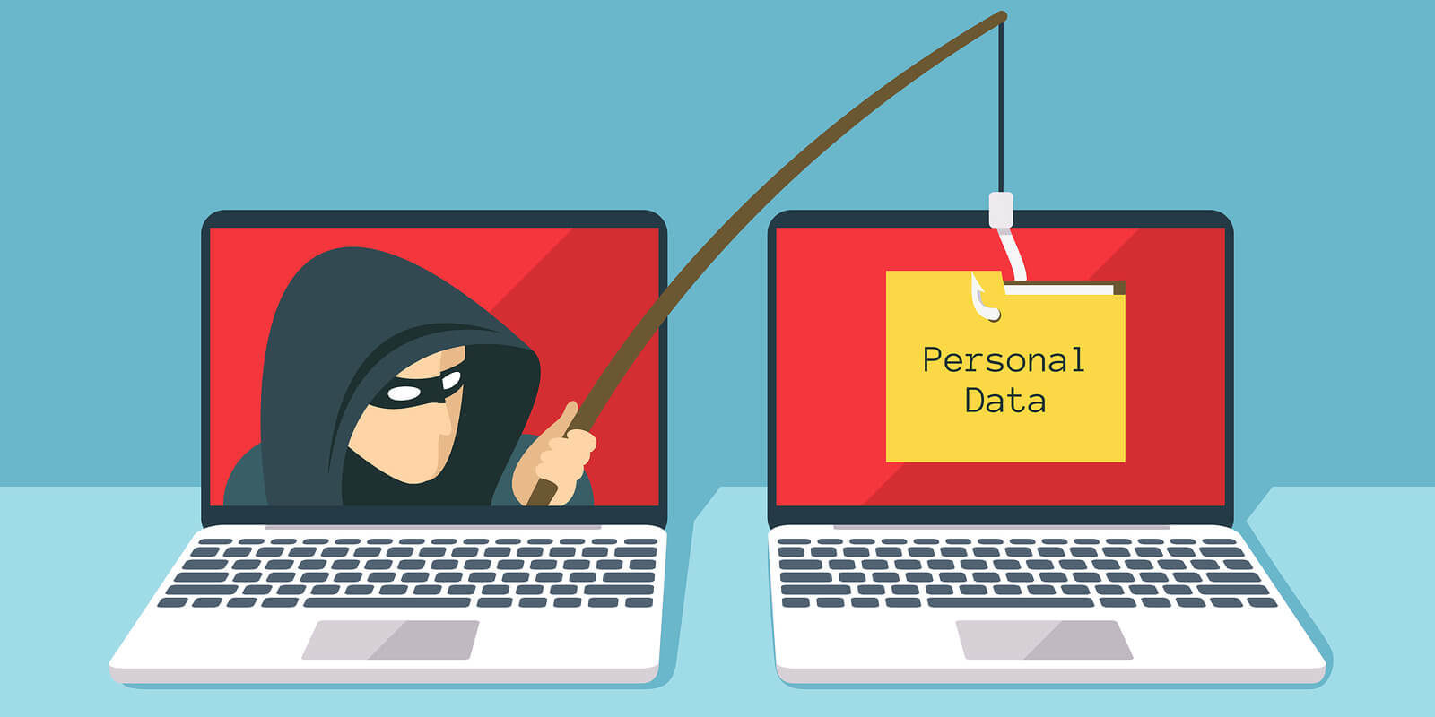
Information Scams
Investigation Form
Website Links
Email Reply
Image by Brie Weiler Reynolds
Notes:
Like by the website links to

Slide 5
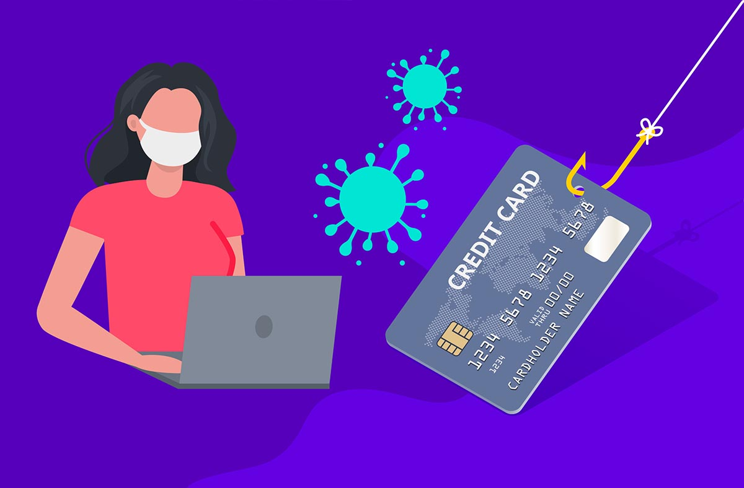
Money Scams
Online Loan
Letter of Credit Fraud
Investment Fraud
Fake Fee Payment
Image by Jason Kaye
Notes:
Investment fraud is an offer using false or fraudulent claims to solicit investments or loans, or providing for the purchase, use, or trade of forged or counterfeit securities.
L

Slide 6
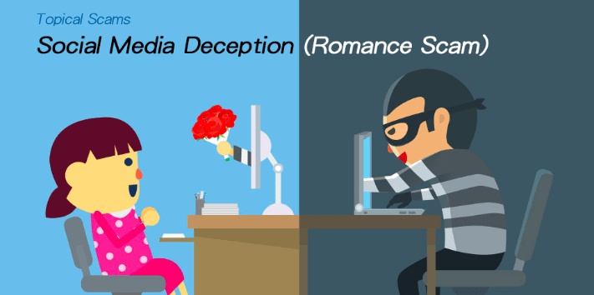
Social Scams
Social Media
Online Dating
Online Friends
Image by Hong Kong Police

Slide 7
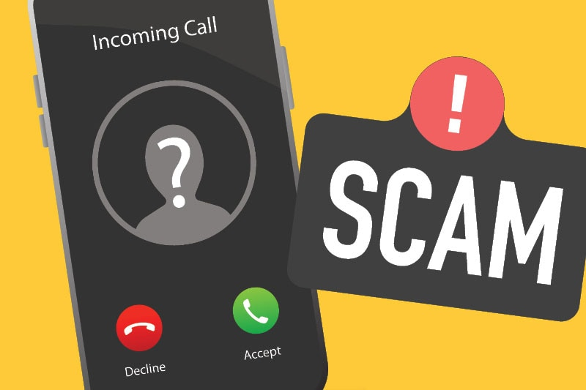
Telephone Scams
In 2021, HK have 180 Cases (Higher than Others)
Image by Australia Government

Slide 8
Influence by Scams

Slide 9

Money Loss
More than Seventy-two Million in AU
Image by Youck from iStock
Notes:
That’s a common affect after scams, Money loss. A lot of target of scams is people’s money. The Austrila Government shows their country already loss more than seventy-two million money to 2022. Faced with such a huge money loss, scams are causing a damaging impact on social stability which makes the social order more unstable, some people because of that, they have lost hope in their life. And the

Slide 10

Mental Health Problem
Image by solarseven from Shutterstock
Notes:
Mental health problem is more terrible than money less. Some people like elder people or people who not good in handle stress will be get that. From report by UK AGE origination, their research already said the elder people very difficult to handle it. Also the news report by Drash said some people in Jamaica, people because the lottery scams, they suicide by mental health influence. Also

Slide 11
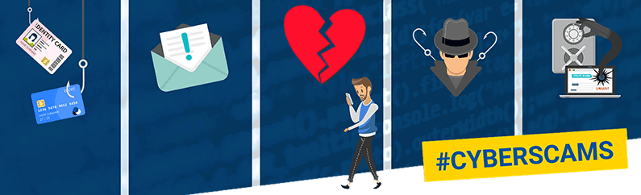
Lost Trust Between People and People
Image by European Banking Federation
Notes:
The scams also will cause the trust decline between people and people, people will be losing the ability to believe, also people will be more suspicious after scams from UK Security Center.
The Australia government said, scams can let the trust between people and government to be decline, because of government's management functions not enable for scams when scams happen.

Slide 12
Solving Method

Slide 13

Government
Image by Government Marketing & Procurement, LLC
Notes:
The governments or organizations also need to do some things to avoid their people scammed. They can have some lectures for avoiding scams in a period, which use the trust between people and the government to start publicity.

Slide 14
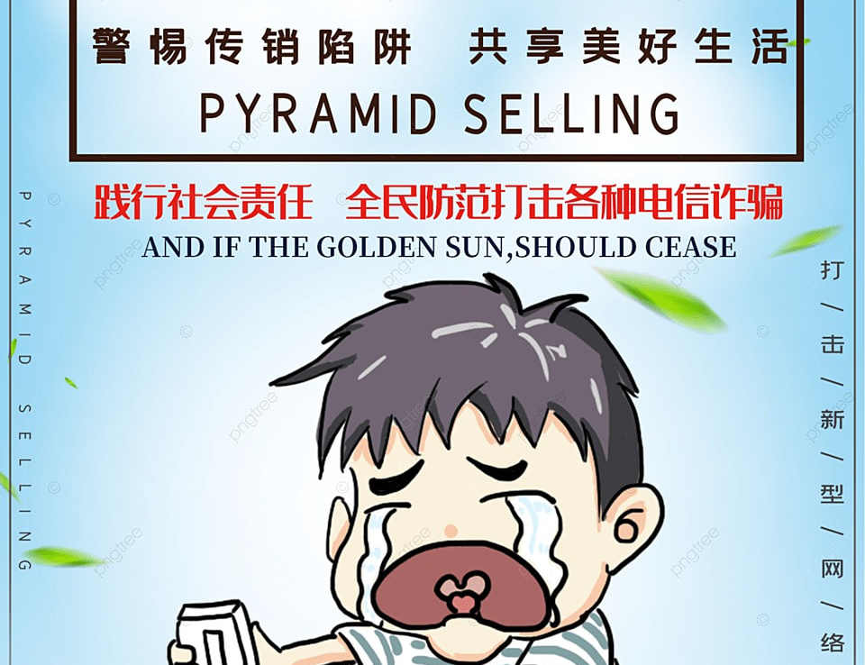

Community Publicity
Image from pngtree
Image by Gillian Barnes
Notes:
Also, communities can have some publicity or simulate for everyone to learn and avoid scams. For example, the first picture in this page shows the community in Mainland, China post the anti-scams animations.

Slide 15
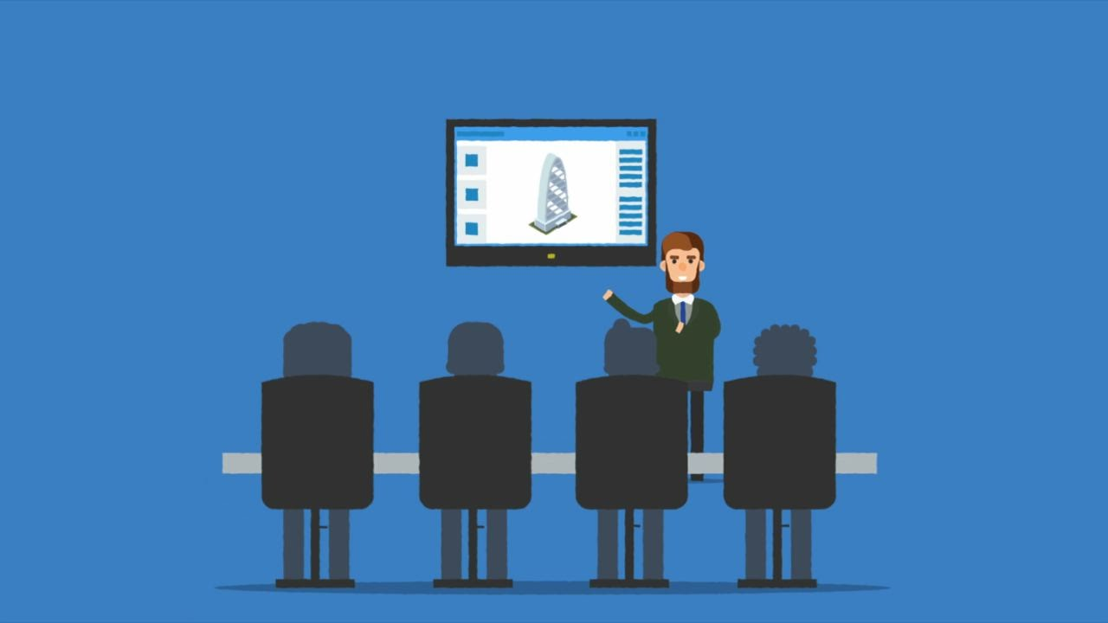
Technology Company
Image by Just Holler
Notes:
Some technology companies also can use social media to promote, if they want, they can use their technology to help people to avoid those scams. Like Instagram can use their platform to block some scam messages or scammers.

Slide 16
References
[1] Age UK, Scamming and its effect on vulnerable individuals, Sep-2016. [Online]. Available: https://www.ageuk.org.uk/globalassets/age-uk/documents/reports-an d-publications/reports-and-briefings/safe-at-home/rb_oct17_scams_party_confe rence_paper_nocrops.pdf. [Accessed: 23-Feb-2022].
[2] Australian Government Commonwealth Fraud Prevention Centre, “The total impacts of fraud,” Commonwealth Fraud Prevention Centre, 20-Jul-2020. [Online]. Available: https://www.counterfraud.gov.au/total-impacts-fraud. [Accessed: 23-Feb-2022].
[3] E. Williams, “What makes people susceptible to malevolent influence online?,” CREST Research, 27-Apr-2017. [Online]. Available: https://crestresearc h.ac.uk/comment/williams-susceptible-malevolent-influence-online/. [Accessed: 23-Feb-2022].
[4] Australian Competition and Consumer Commission, “Scamwatch Role,” Australian Competition and Consumer Commission, 28-Aug-2019. [Online]. Available: https://www.scamwatch.gov.au/about-scamwatch/scamwatch-role. [Accessed: 18-Mar-2022].
[5] W. Drash, “Driven to death by phone scammers,” Driven to death by phone scammers -CNN, 08-Oct-2015. [Online]. Available: https://edition.cnn.com/2015/10/07/us/jamaica-lottery-scam-suicide/index.html. [Accessed: 18-Mar-2022].
[6] Regions Bank, “How to avoid scams: Tips for college students,” How to Avoid Scams: Tips for College Students. [Online]. Available: https://www.regions.com /insights/Personal/Life-Stages/school-years/how-to-avoid-scams-in-college. [Accessed: 17-Mar-2022].
[7] A. Baillon, J. de Bruin, A. Emirmahmutoglu, E. van de Veer, and B. van Dijk, “Informing, simulating experience, or both: A field experiment on phishing risks,” PLOS ONE, vol. 14, no. 12. Public Library of Science (PLoS), p. e0224216, Dec. 18, 2019. doi: 10.1371/journal.pone.0224216.

Slide 17
THANKS

